Slide 1

Screenshot
Step–by-Step Procedure

Slide 2
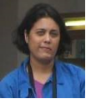
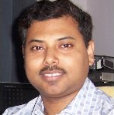
Project Investigators
Dr. Liza Das
Principal Investigator
Dr. Pradip K. Das
Co-Investigator

Slide 3
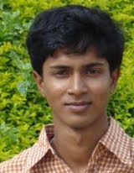
Project Staff
Dwipayan Das
Assistant Project Engineer

Slide 4
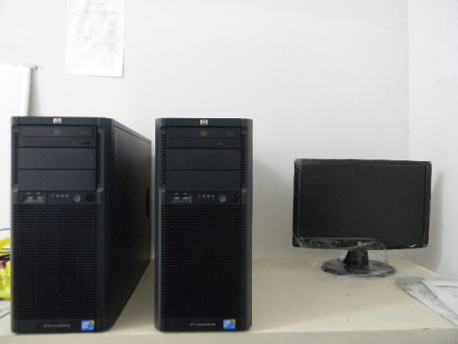
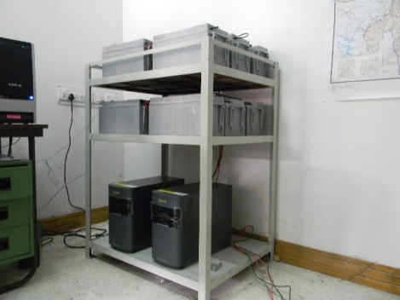
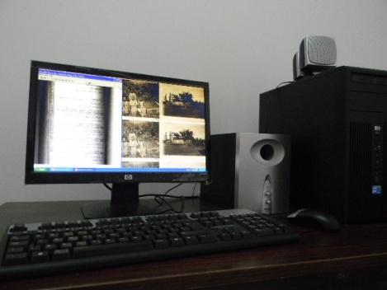
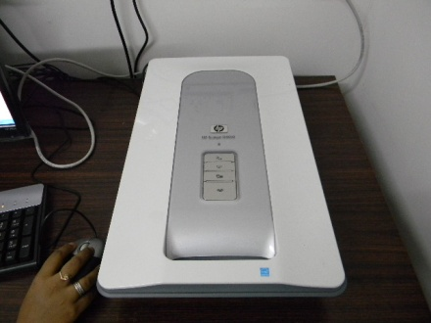
Equipment Procured
SERVERS
ONLINE UPS
PC & Audio/Visual Unit
Flatbed Scanner

Slide 5
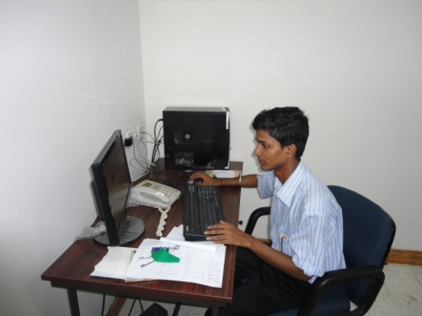
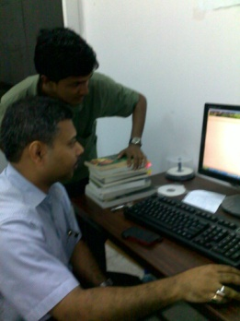
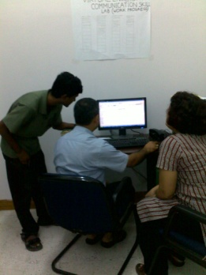
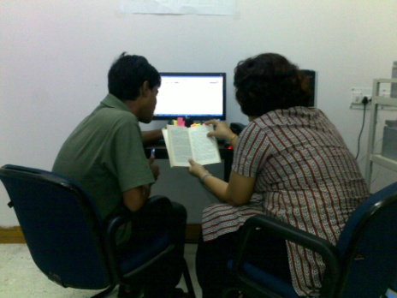
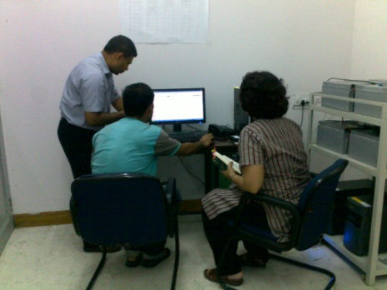
Laboratory Photographs

Slide 6
Software
Adobe Flash
MS Office
Adobe Photoshop
Sound Forge
VCD Cutter and Converter

Slide 7
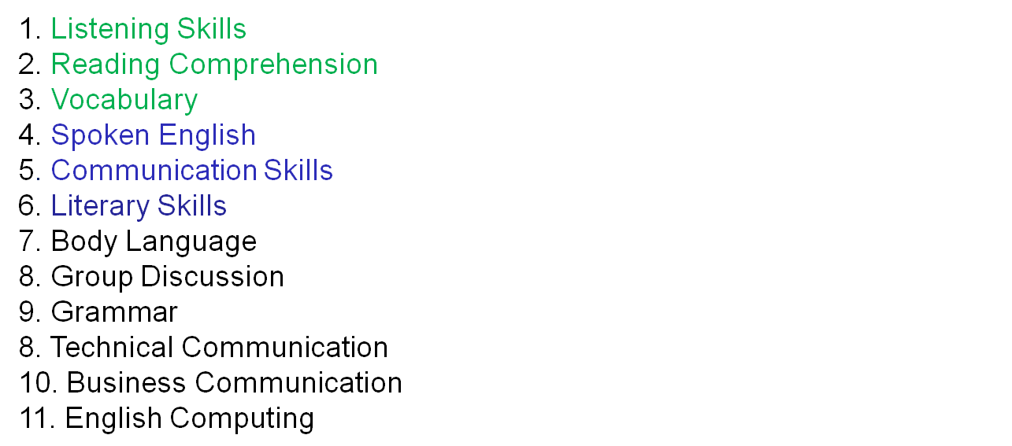
Complete list of modules for two years

Slide 8
Module 1: Listening Skills
Animation
Tips on listening skills
Exercise-1 (Source:)
Exercise-2 (Source:)
Exercise-3 (Source:)
Exercise-4 (Source:)
Exercise-5 (Source: “Laburnum For My Head” Temsula Ao)
Exercise-6 (Source: “The Boy Who Sold an Airfield” Temsula Ao)
Exercise-7 (Source: “The Legends of Pensam” Mamang Dai)
Exercise-8 (Source: “Travel the Road” Mamang Dai )
Exercise-9 (Source: “Death in a Hut” Kynpham Sing Nongkynrih)
Exercise-10 (Source: “The Prisoner” Harekrishna Deka )

Slide 9
Module 2: Reading and Comprehension
Video Lecture by Experts (M B Bora, Cotton College)
PPT turn to animation (MIT)
Crosswords (1) (2) (3) (4)
Exercise 1: (Source: “The Twilight Hour” Kula Saikia)
Exercise 2: (Source: “ The Bride” Indira Goswami)
Exercise 3: (Source: “Munni’s Legs” Atulananda Goswami)
Exercise 4: (Source: “The Seven Clans” Kynpham Sing Nongkynrih)
Exercise 5: (Source: “Ka Nam and the Tiger” Kynpham Sing Nongkynrih)
Exercise 6: (Source: “The Unwritten Story” Pranavjyoti Deka)
Exercise 7: (Source: The Hour before Dawn Bhabendranath Saikia )
Exercise 8: (Source: “The Heart of the Insect” Mamang Dai)
Exercise 9: (Source: “The Words of Women” Mamang Dai)
Exercise 10: (Source: “Luck” Dhruba Hazarika)

Slide 10
Module 3: Vocabulary
Antonyms (10 exercises)
Synonyms (10 exercises)
Word Jumble (15 exercises)
Greek and Latin Root Words (50)
Latin Phrases(20)
Animation
Video Lecture on Vocabulary by Prof. Krishna Barua (forthcoming)

Slide 11
Next Phase
Spoken English
Video Tutorial by Santanu Phukan, Department of English, Cotton College
Literary Skills
Video Tutorial by Dr R K Moral, Department of English, Cotton College
Communication Skills
Audio Tutorial by Dr Liza Das
Power point (1) (2) (3) (4) (5)
Animation Files

Slide 12
External Links
http://writing-program.uchicago.edu/resources/grammar.htm
http://www.enhancemywriting.com/
http://www.webenglishteacher.com/creative.html
http://www.ehow.com/how_4897636_teach-creative-writing-activities.html
http://www.oneofus.co.uk/index.php/how_to/how_to_create_fantasy_worlds/

Slide 13
External Collaboration
Human Resources at MIT, USA
Department of English, Cotton College
Department of English, Gauhati University
CIEFL Shillong
CIEFL Hyderabad
ORELL Technologies

